Slide 1








Exhibition Pitch:
Advanced Sensing for Battery Development and Testing &
NEXT-generation physics and data-based Battery Management Systems for optimised battery utilization
NEXTBMS
Bernhard Stanje - AVL
Hansjörg Kapeller - AIT
RND 2024

Slide 2



NEXT-generation physics and data-based Battery Management Systems for optimised battery utilisation
General information
Topic:
Physics and data-based battery management for
optimised battery utilisation (Batteries Partnership)
Topic identifier:
HORIZON-CL5-2022-D2-01-09
Type of action:
Research and innovation action (RIA)
Coordinator:
AIT Austrian Institute of Technology GmbH
Grant agreement number:
101103898 - NEXTBMS
Maximum grant amount:
4,998,318.25 EUR
NEXTBMS.eu
Funded by the European Union under grant number 101103898. Views and opinions expressed are however those of the author(s) only and do not necessarily reflect those of the European Union. Neither the European Union nor the granting authority can be held responsible for them.

Slide 3
Consortium

Slide 4
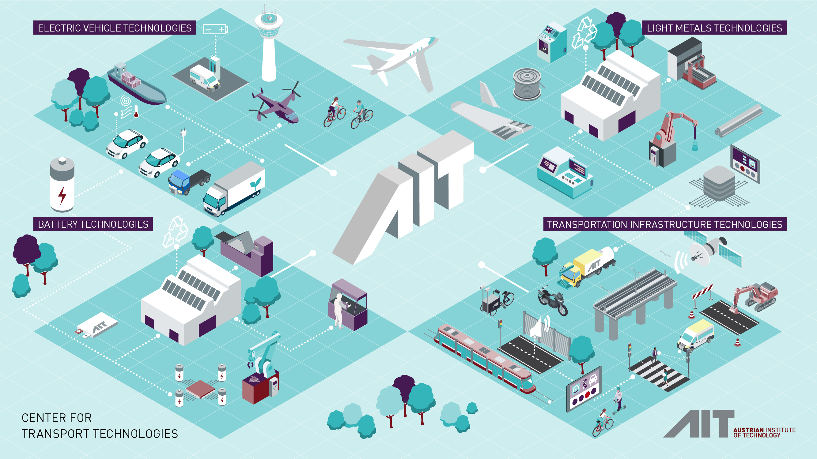

Slide 5
NEXT-generation physics and data-based Battery Management Systems for optimised battery utilisation
Aim of NEXTBMS
Development of an advanced battery management systems (BMS)
  built on fundamental knowledge and experience with the physicochemical processes of LIBs,
  enhancing significantly current modelling approaches, including the readiness for upcoming LIB material developments.
NEXTBMS further introduces optimized sensors and measurement techniques
  to meet modelling needs and to optimize models based on physical sensor data,
  crucial for physical cell configurations to form a framework for advanced battery state prediction and –control
NEXTBMS ensures that the next generation of BMSs will enable higher performance, safety, and longer lifetime of the battery cells for an overall optimal utilization of the battery system.

Slide 6
NEXT-generation physics and data-based Battery Management Systems for optimised battery utilisation
Technical Objectives (TO)
NEXTBMS will realize this by means of the following scientific and technical objectives (TO)
  TO 1 Advanced physics-based and adaptable battery models
  TO 2 Advanced data acquisition combining sensor-based solutions at battery system/module level and model generated values
  TO 3 New control algorithms with advanced state estimators and data-based algorithms to increase utilization while ensuring safety and reliability of the advanced BMS system

Slide 7
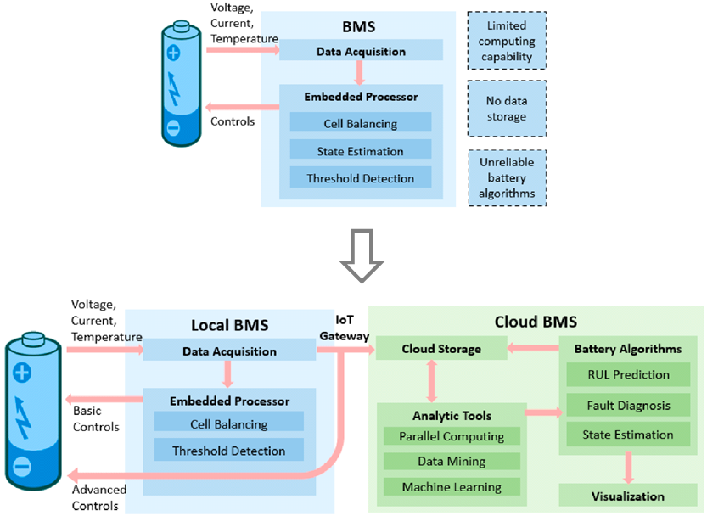
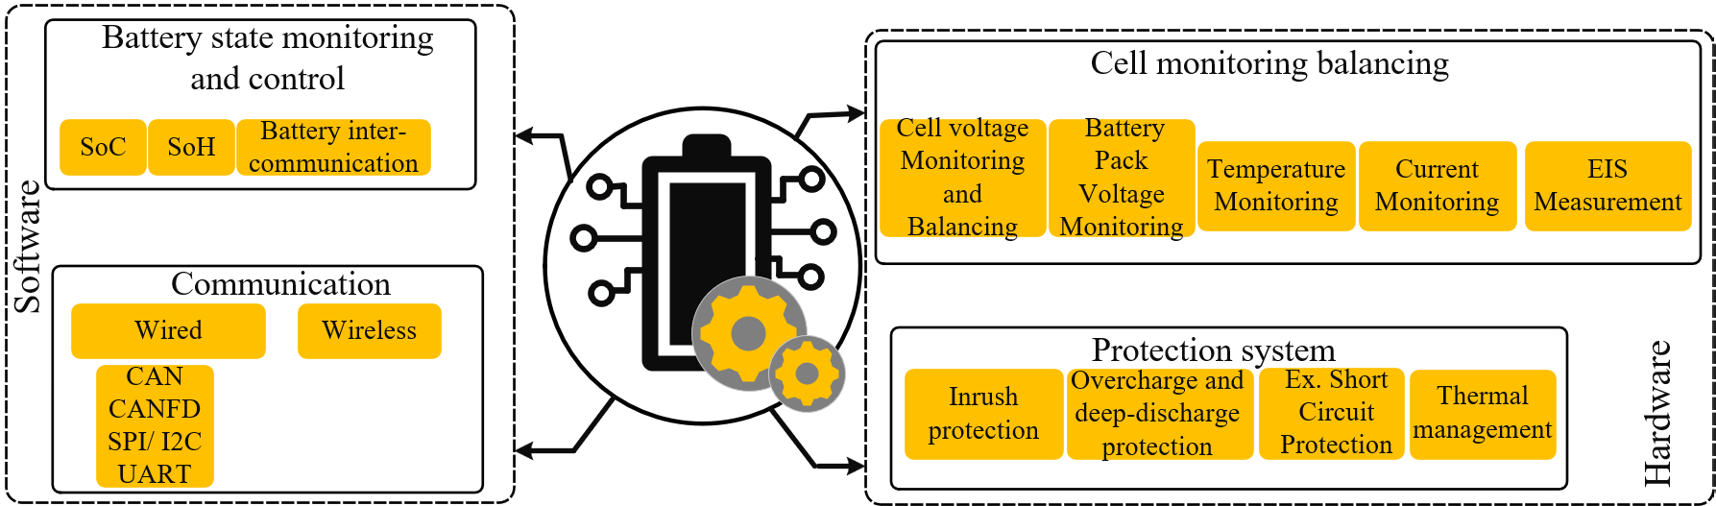
NEXT-generation physics and data-based Battery Management Systems for optimised battery utilisation
Requirements capture and impact assessment
New solutions that facilitate the efficient and durable use of LIB to improve performance
  in the xEV mobile sector, by strengthening of sustainability aspects (like predictability, state estimation quality) and lower cost basis
  in stationary applications such as grid balancing
  and storage of energy from variable renewable
  sources (e.g. wind or solar energy)

Slide 8
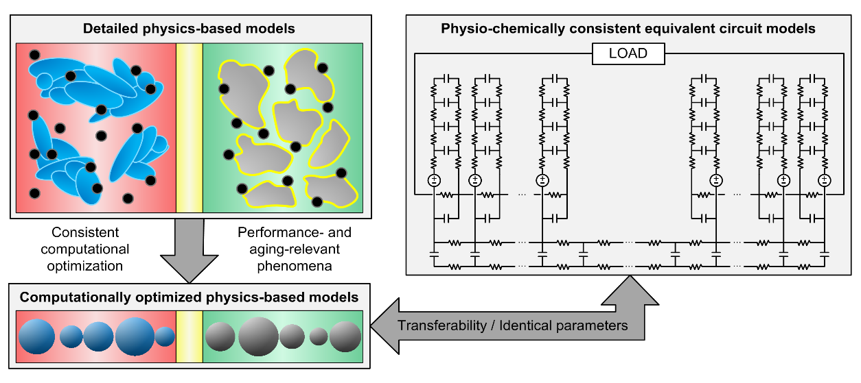
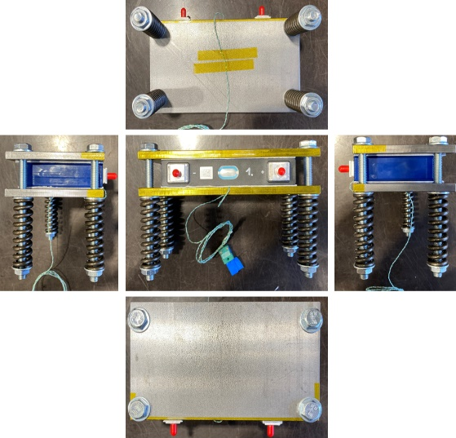
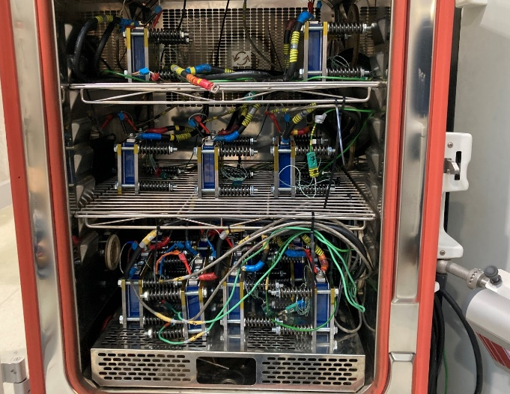
NEXT-generation physics and data-based Battery Management Systems for optimised battery utilisation
TO1: Physics and data-based models and BMS software
Development of scalable physics-based BMS models tracking the performance and degradation states of the battery with higher accuracy compared to currently applied semi-empirical BMS models
For the parameterization of the physio-chemically consistent equivalent circuit models, electrical and aging characterization tests for NMC chemistries are currently performed
AIT, along with project partner TNO, is responsible for the electrical and aging characterization tests of the NMC cells to be used for the NEXTBMS battery module prototypes

Slide 9
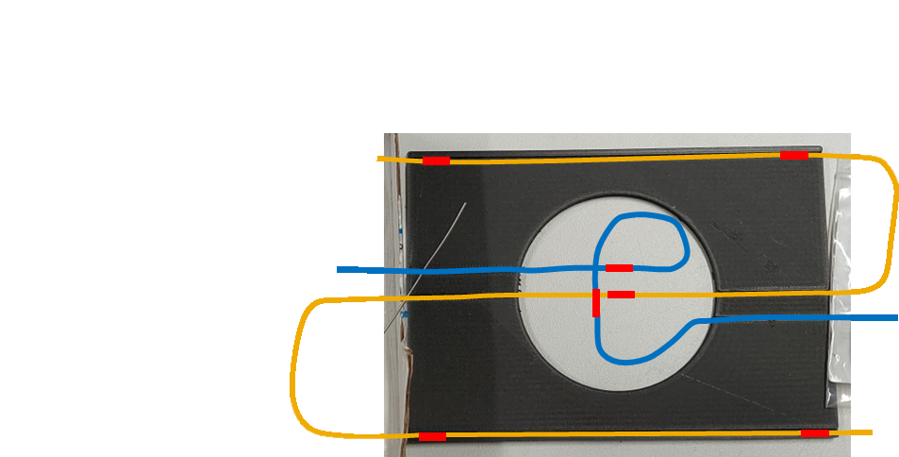
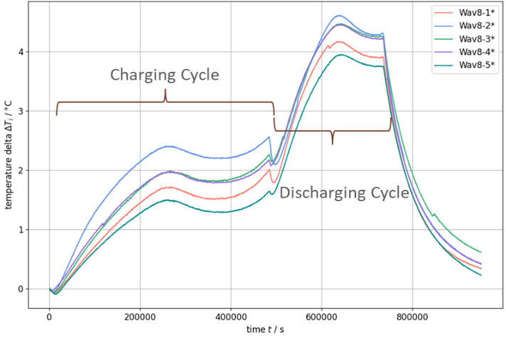
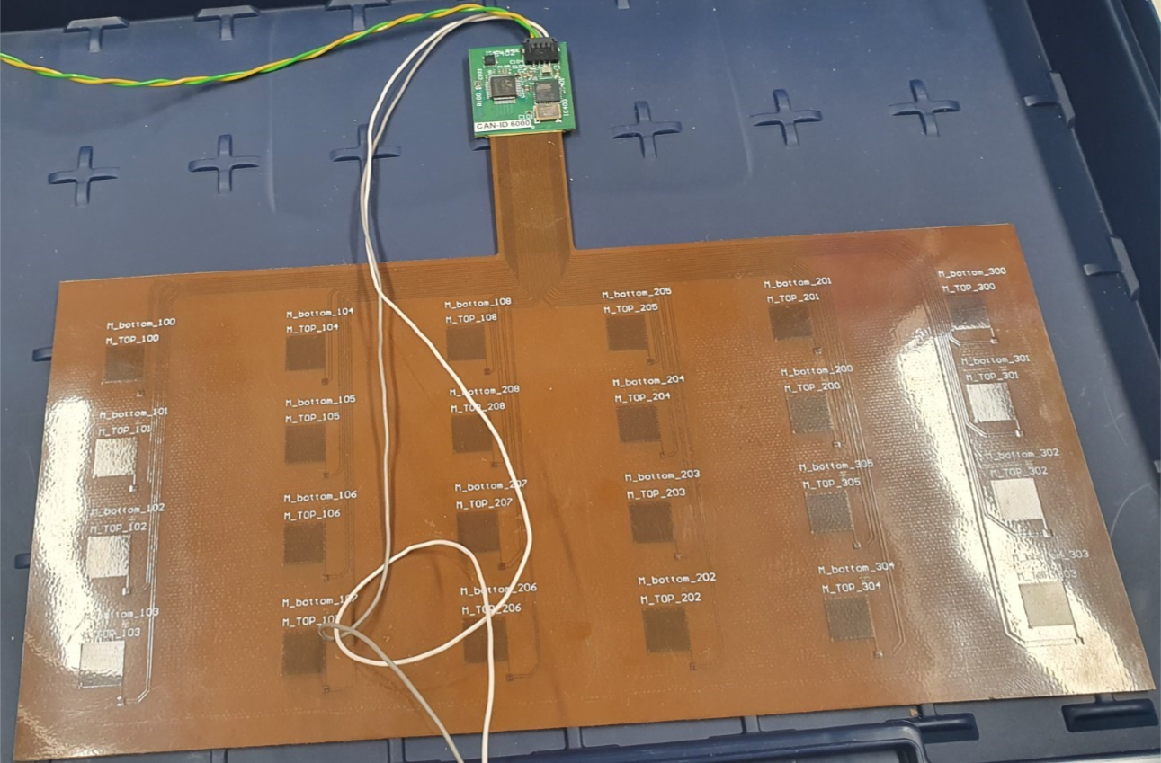
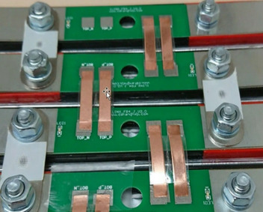
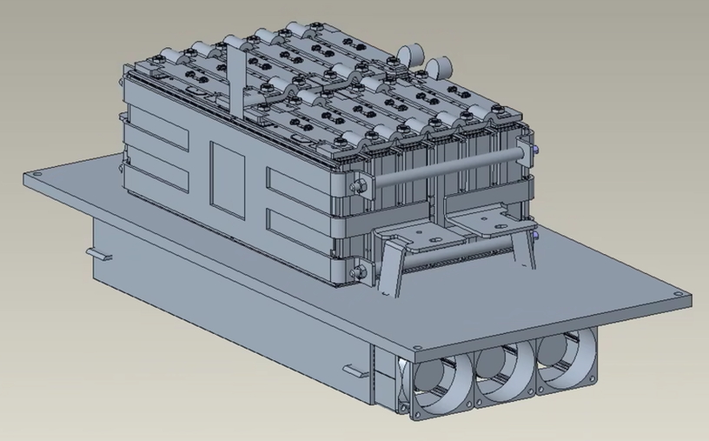
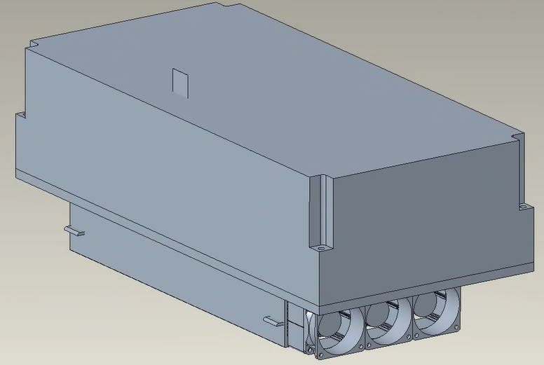
NEXT-generation physics and data-based Battery Management Systems for optimised battery utilisation
TO2: Development and prototyping modular battery modules with BMS HW
Modelling approaches are improved by optimizing HW sensors
and measurement techniques
Combining physical sensor information with virtual sensors (model outputs) enables accurate estimation of SoC, SoH, SoF and SoP
Use of advanced HW sensors for more accurate
  temperature measurements with higher spatial resolution (fibre optical sensors)
  mechanical strain measurement (Li plating and safety indications)
  synchronised voltage- and current measurement
  on-board electrochemical impedance spectroscopy (EIS)
Housing design, E/E design and BMS development
AIT assembles two lab-scale prototype modules
  testing of the battery module prototypes and the innovative sensor concept developed by AVL

Slide 10
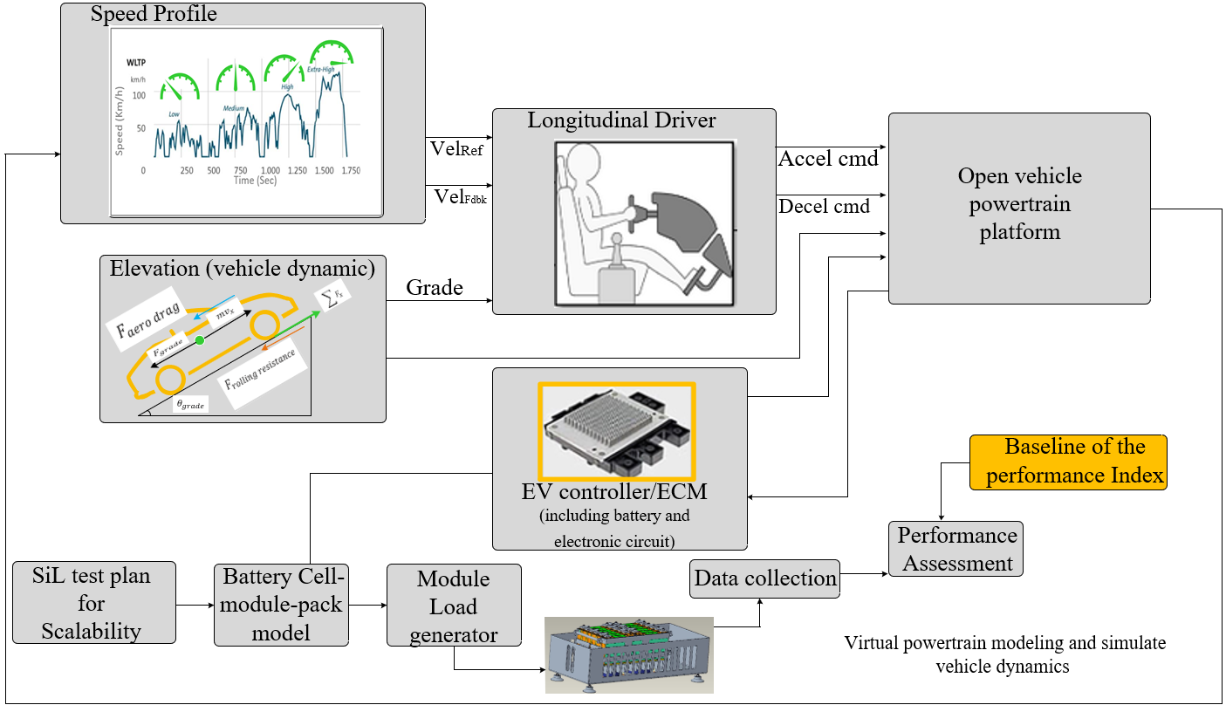
NEXT-generation physics and data-based Battery Management Systems for optimised battery utilisation
TO3: Use case realisation on lab-scale and upscaling towards system-level validation
Performance test of the BMS
through HiL
SiL approaches will be used to virtually upscale the prototype to a system voltage of 400V and 800V
Vehicle simulation platforms are used
to develop appropriate battery pack sizing methodology for EV applications
Using the vehicle simulators, power and energy demands for different mission profiles will be acquired
An EDF lab-grid/platform will be utilized for stationary applications
T4.1
T4.2
T4.2
T4.2
T4.4
T4.1
T4.3

Slide 11











NEXT-generation physics and data-based Battery Management Systems for optimised battery utilisation
Thank you
NEXTBMS.eu
Funded by the European Union under grant number 101103898. Views and opinions expressed are however those of the author(s) only and do not necessarily reflect those of the European Union. Neither the European Union nor the granting authority can be held responsible for them.

